Slide 1
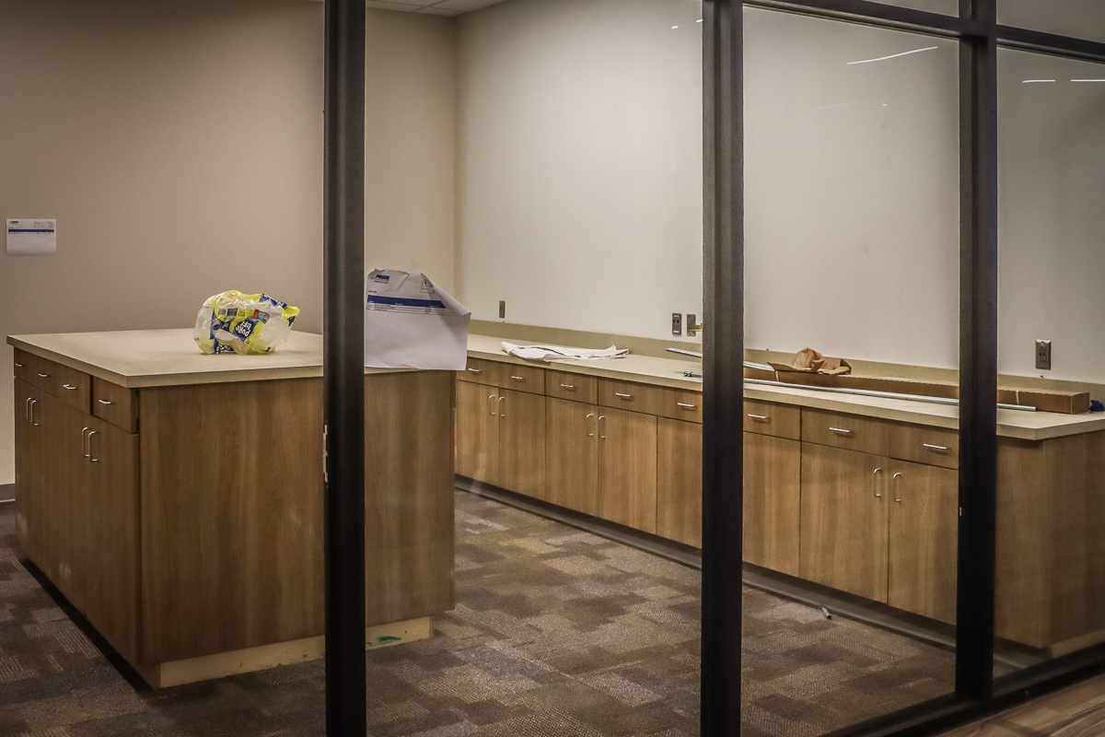
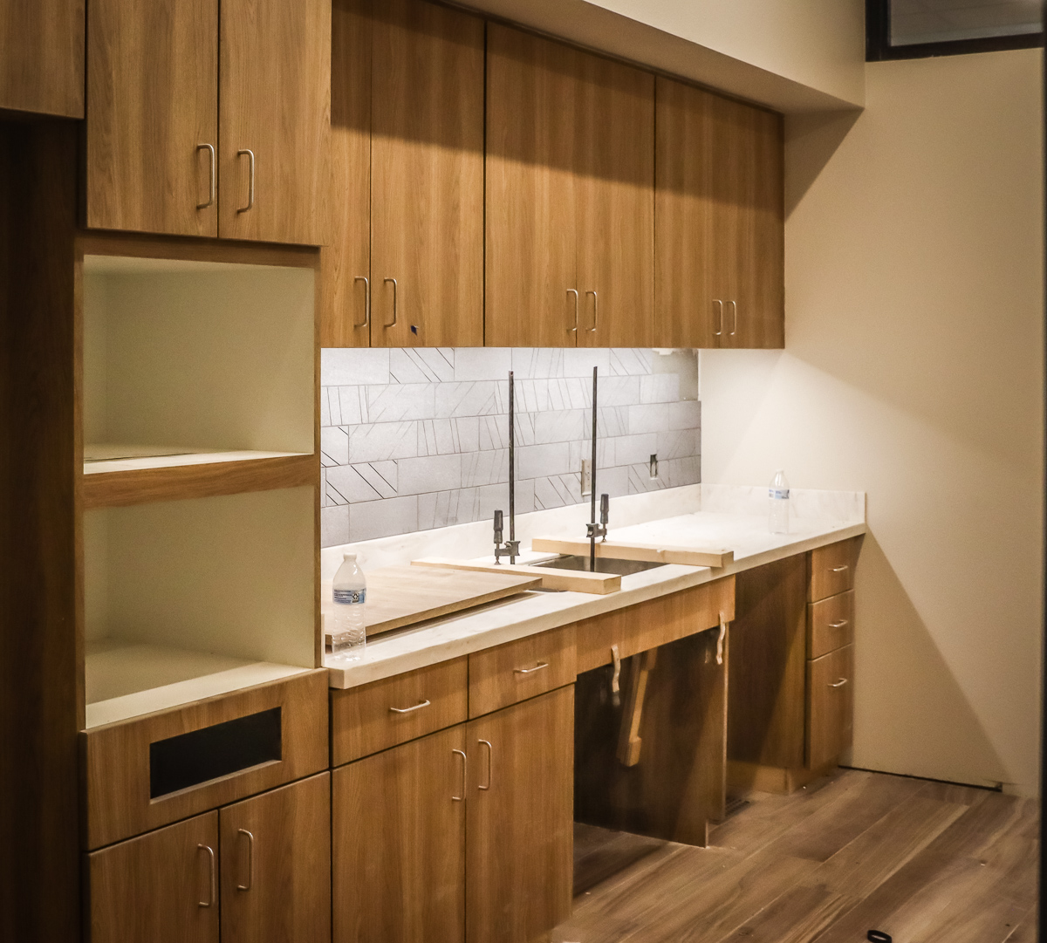
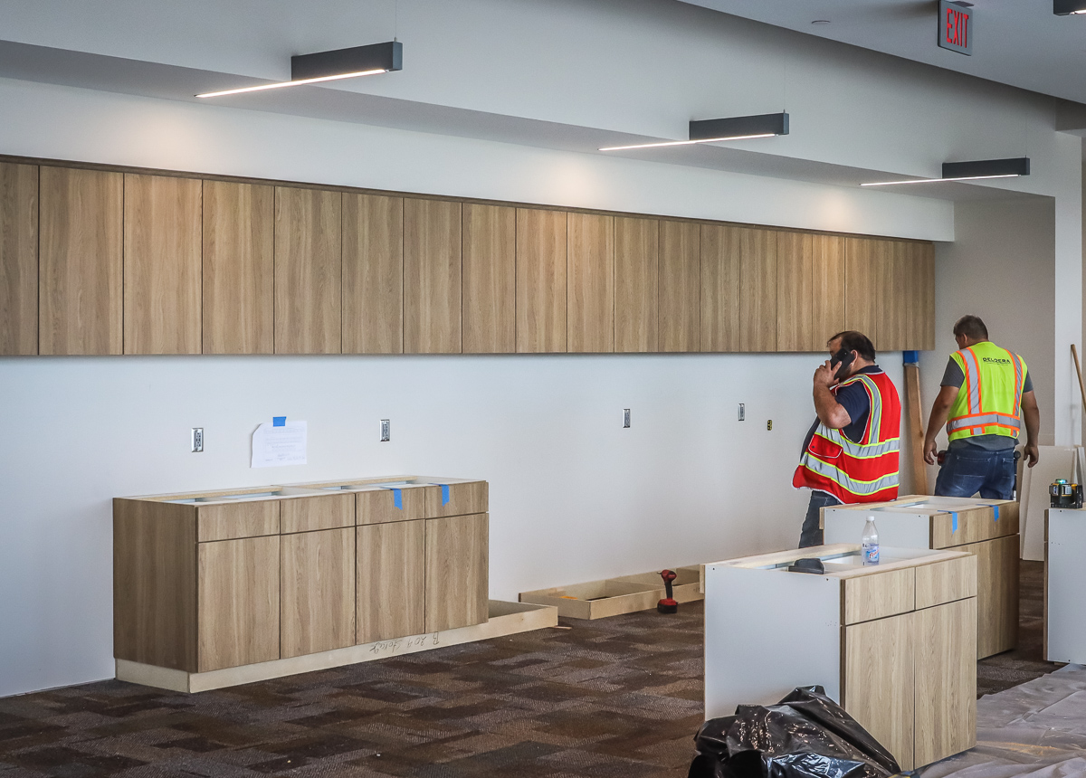
ADMINISTRATION BUILDING
Millwork continues in Area B on the main and upper level.

Slide 2
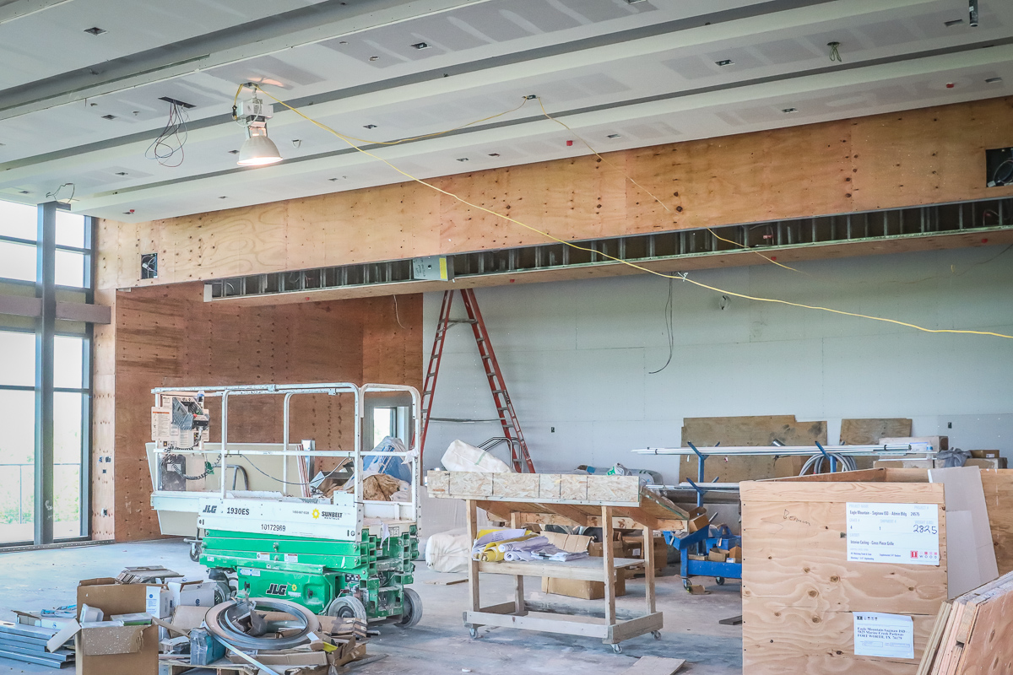
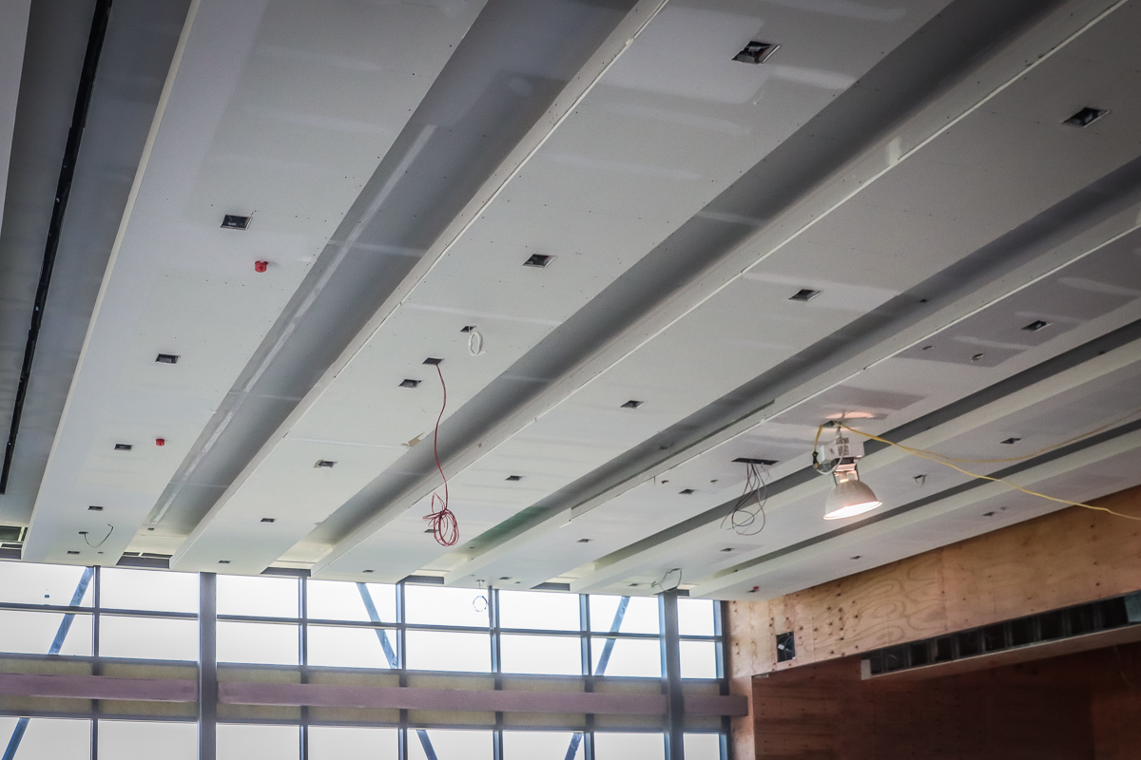
Ceiling and sheetrock continue in board room.

Slide 3
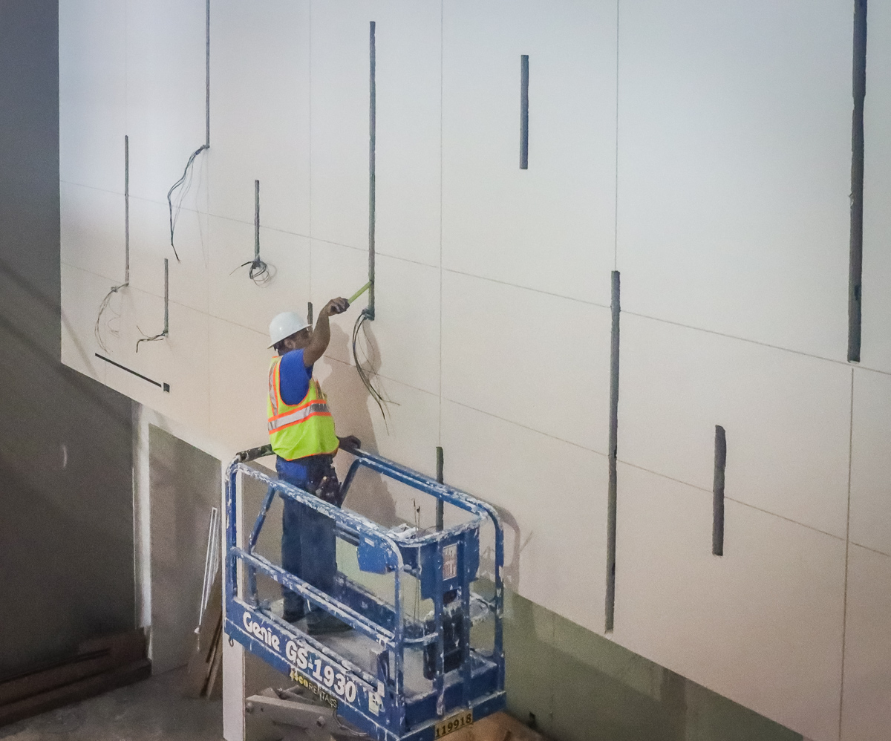
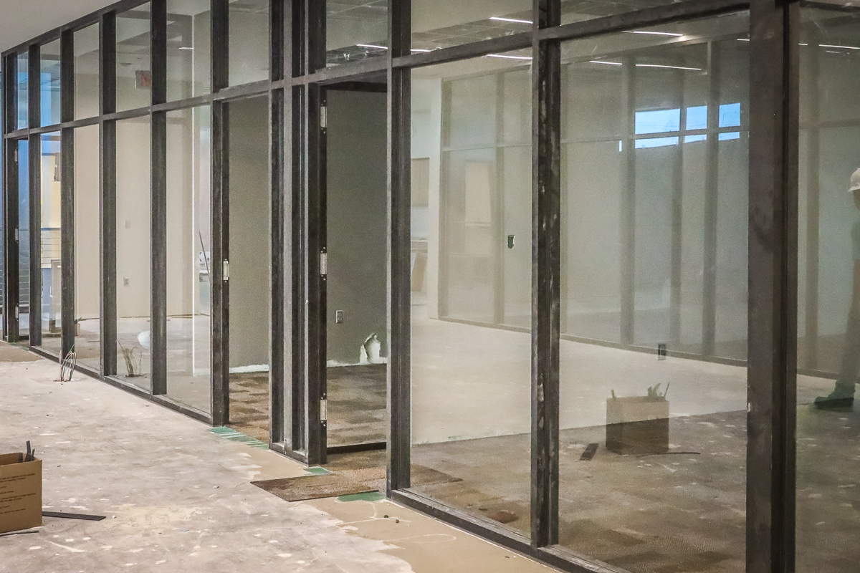
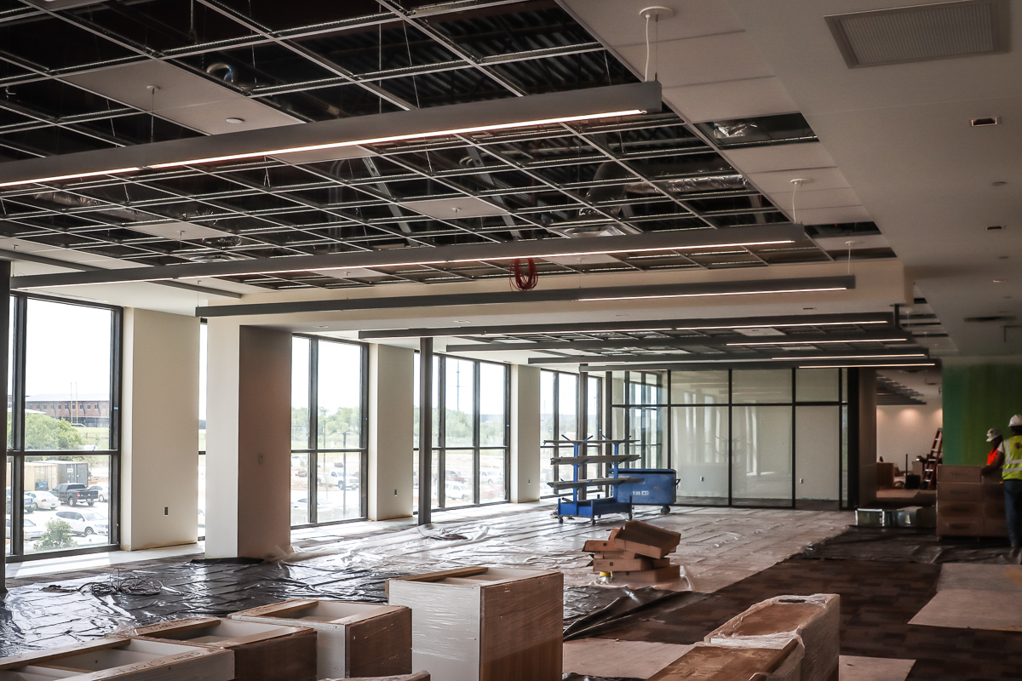
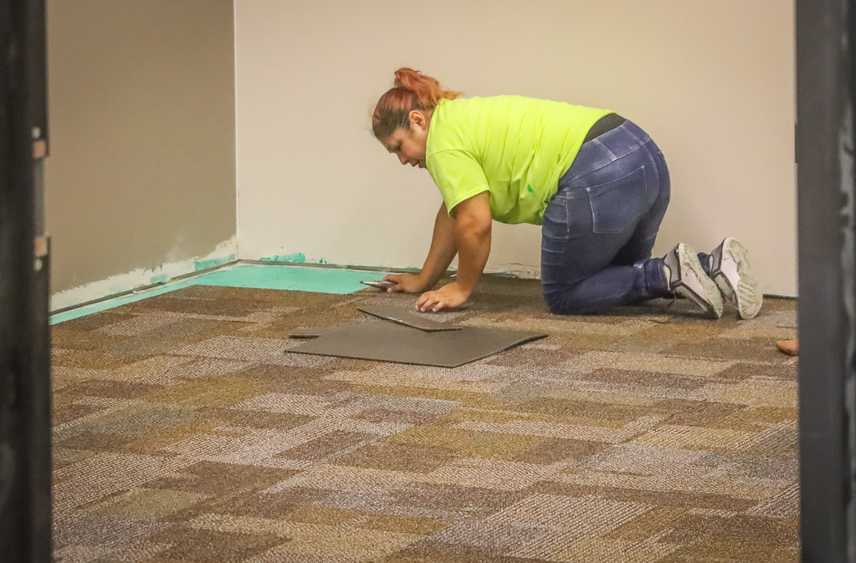
Carpet and lighting continue in Area B on the main and upper level

Slide 4
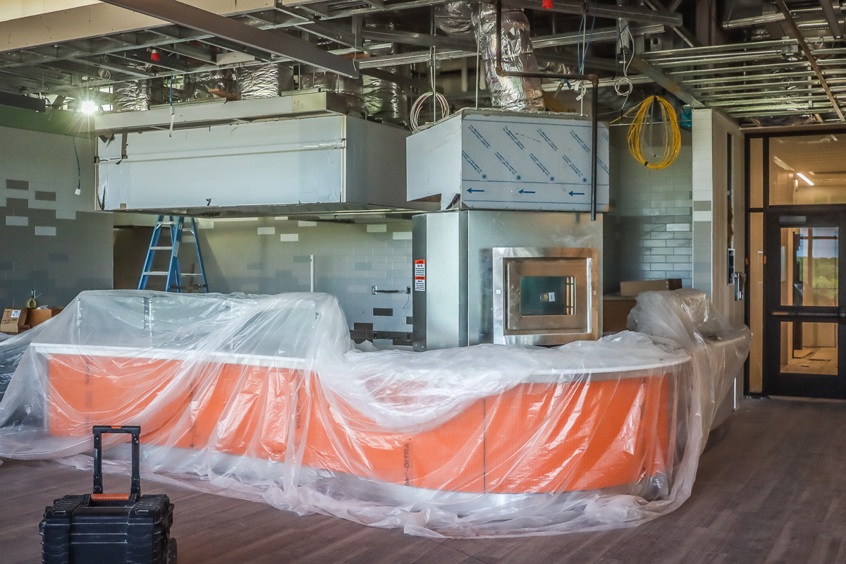
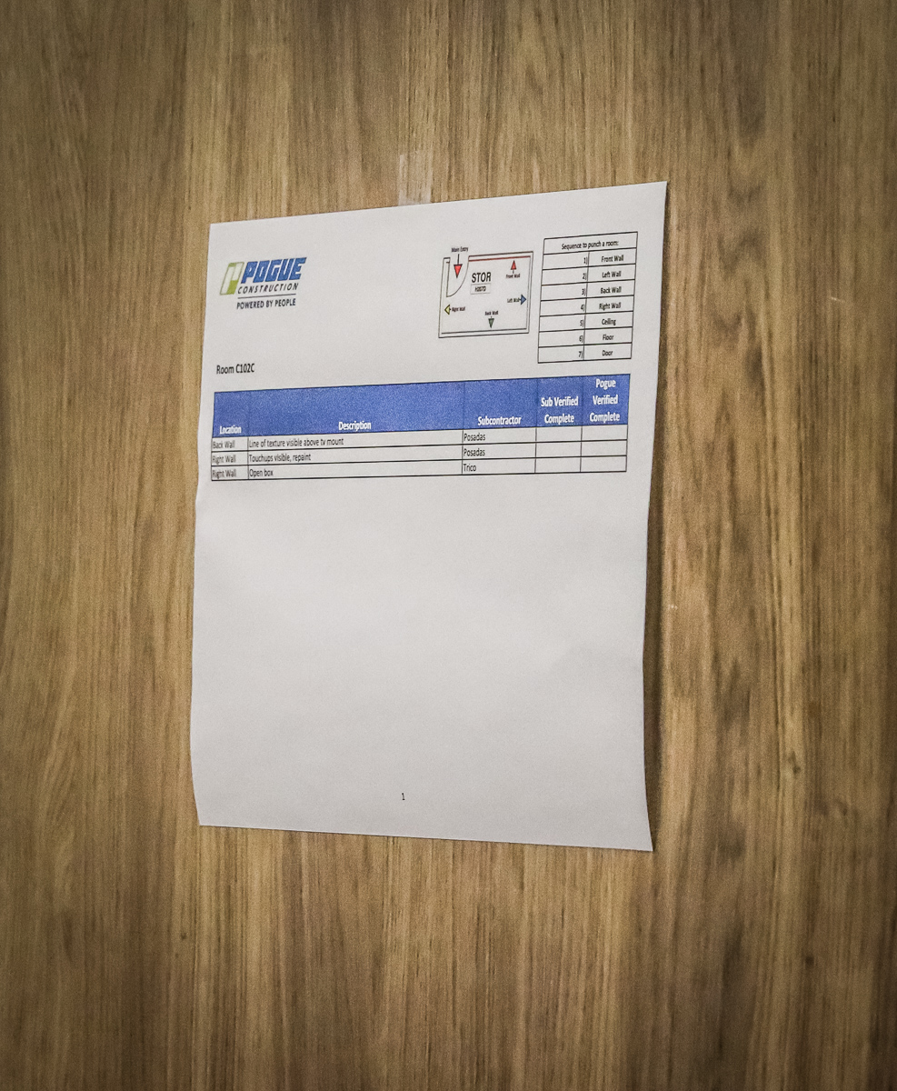
Bistro equipment continues to be installed, and punch items in Area A continue.

Slide 5
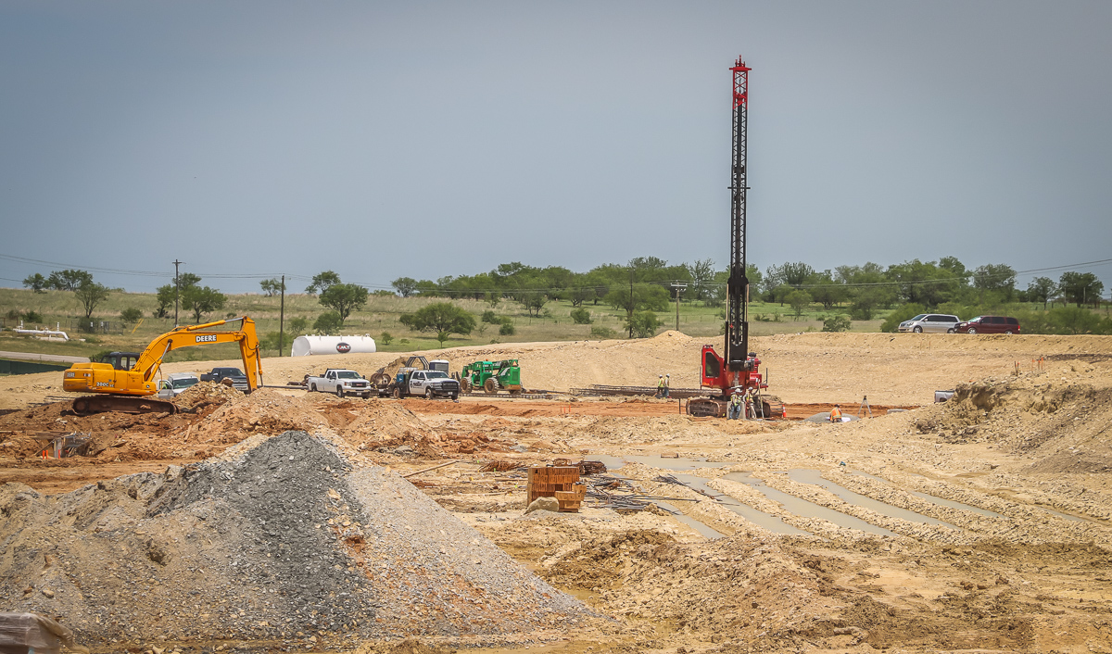
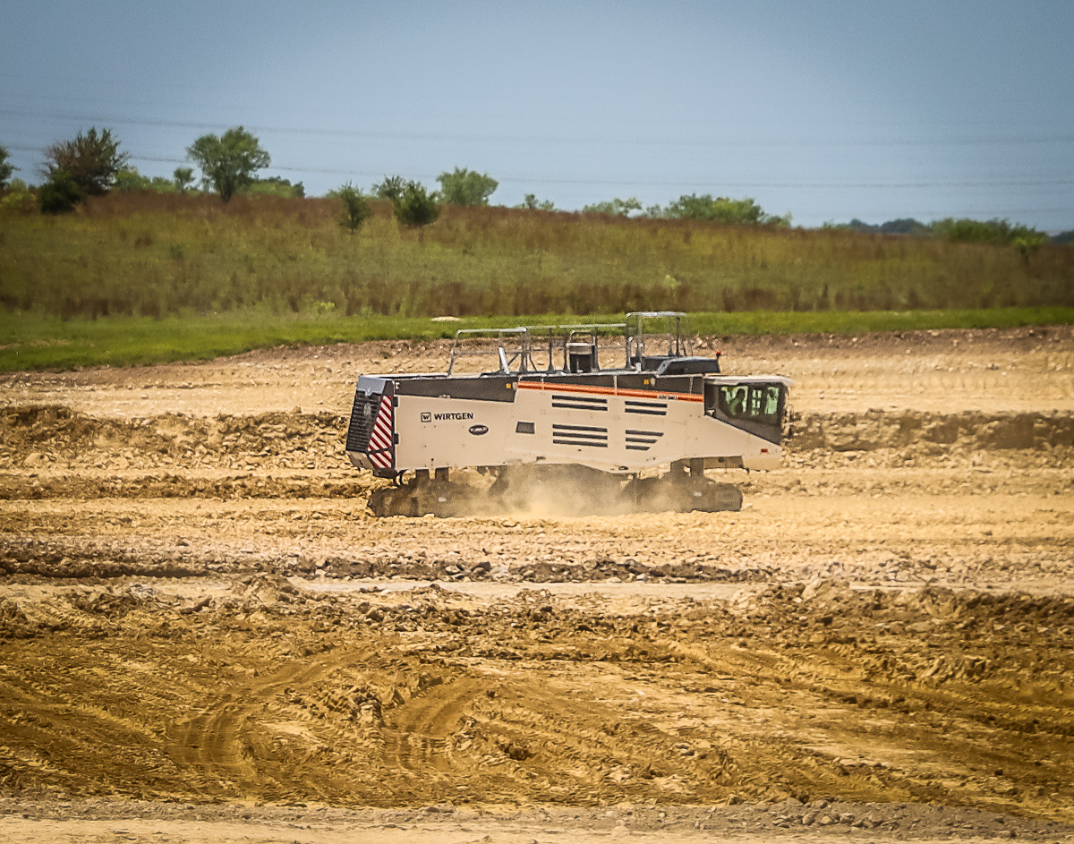
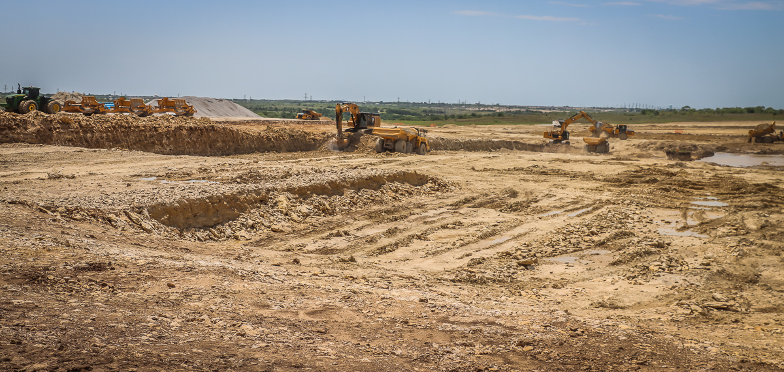
EAGLE MOUNTAIN HS
Building pad preparation continues along with grade cuts.

Slide 6
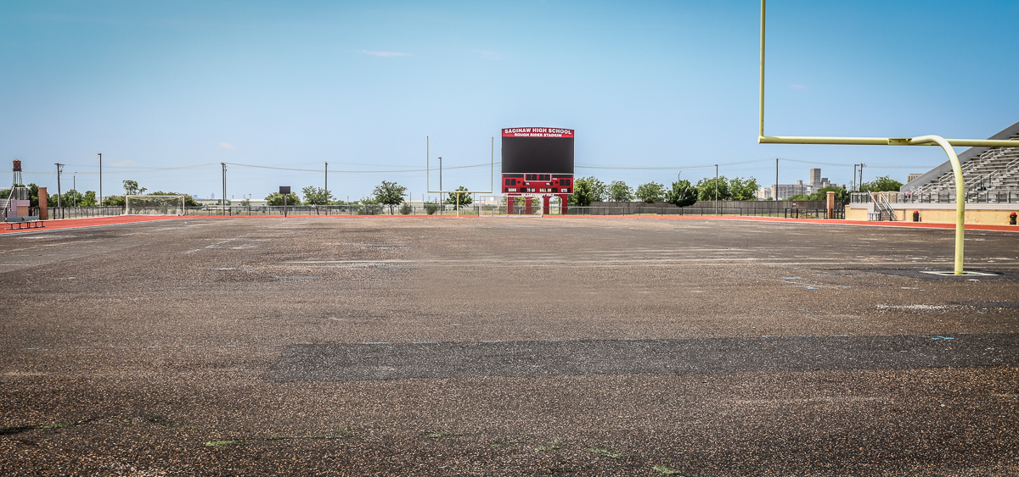
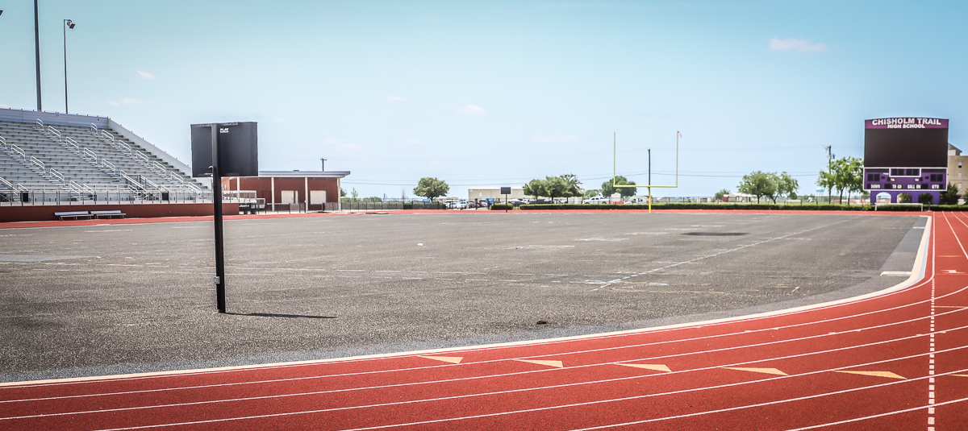
TURF PROJECTS
Turf projects are on schedule at Chisholm Trail HS and Saginaw HS. They are due for completion in July.

Slide 7
ELEMENTARY 18
Contractor will begin dirt work when grading permit is acquired from the city.
August 1, 2023, is the substantial completion of the project.
Attendance zone modifications for this elementary will begin this fall, which will impact the Comanche Springs attendance zone.
Wayside Middle School
Evaluation of the track and tennis court surface is in progress.

